Slide 1
Introduction to Cloud Computing Unit 3- Day6 Advanced Topics
Prashant Kaushal

Slide 2
Recap
Cloud Security

Slide 3
Intercloud
The National Institute of Standards and Technology (NIST) defines cloud computing as “a model for enabling ubiquitous, convenient, on-demand network access to a shared pool of configurable computing resources (e.g., networks, servers, storage, applications, and services) that can be rapidly provisioned and released with minimal management effort or service provider interaction.”
Cloud restrictions:
As the number of cloud users increases, it is a challenge to cater to the requirements of all the users in order to maintain the credibility of the cloud providers.
Cloud providers do not offer an infinite amount of resources and hence may get saturated at some point in time.
In some cases, situations may arise where the cloud provider might not be able to satisfy the requirements of the customers.
In such cases where the cloud provider is faced with an unexpected increase in requirements or need, it has to resort to some methods to ensure customer satisfaction.
It is in such situations that intercloud comes as a boon to the cloud provider.
Intercloud can be basically viewed as a cloud of clouds.

Slide 4
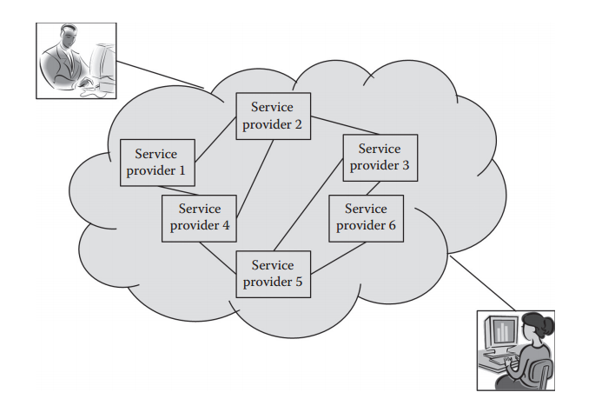
Intercloud

Slide 5
Intercloud
multiple cloud providers join hands to serve the customers.
Intercloud can take any of the two forms: federation of clouds or multicloud.
Federation of cloud is an advantage to the minor cloud providers as they can provide their resources for rent and thus attain profit for their resources, which would otherwise be left underutilized.

Slide 6
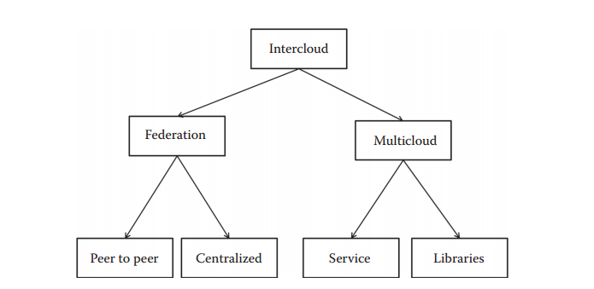
Intercloud

Slide 7
Intercloud - Federation
In federation of clouds, the cloud providers manage the interconnections among them. Here, infrastructures may be shared so as to enable resource sharing. The users need not bother about using more than one cloud as the cloud providers take up the responsibility of providing a transparent service to the customers. Here, one cloud provider can rent the resources of another cloud provider and offer it to the customers.

Slide 8
Intercloud - Multicloud
In multicloud, the client or service makes use of multiple clouds. Thus, the user is aware of the fact that they are being served by more than one cloud provider. It is the responsibility of the users to provide interoperability between the various cloud providers.

Slide 9
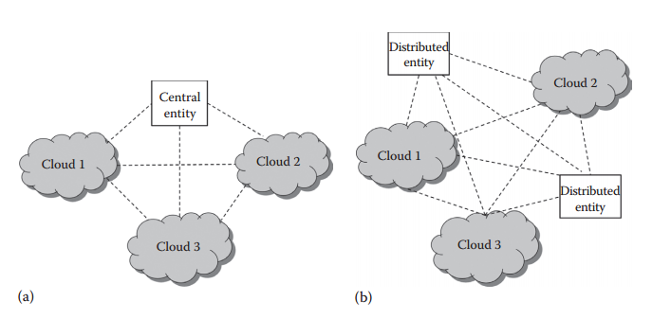
Intercloud - Topologies

Slide 10
Intercloud - Benefits
Diverse geographical locations
Better application resilience
Avoidance of vendor lock-in
Flexibility
Power saving

Slide 11
Intercloud – Key issues
The various cloud providers should have some mechanisms to establish trust among themselves.
SLA requirements and billing rates
the cloud providers should match with each other in terms of resources, policies, technologies, etc
scalability, support of VM migrations across cloud providers, resource migration, security, policy management, and monitoring.

Slide 12
Cloud Management
to ensure the proper functioning of the cloud services.
The cloud management is responsible for managing the infrastructure of the cloud.
It is the solution to the problem of realizing the expected economic benefits, by employing proper capabilities of management
collection of software and technologies that is used to govern and monitor the various cloud applications.
Cloud management ensures that the cloud services are running optimally and that it interacts with its coapplications.
The cloud management software may need to handle heterogeneous resources.
It has to monitor the various tasks such as resource allocation.

Slide 13
Cloud Management
The strategies for cloud management include regular monitoring and auditing services, and initiating and managing plans for disaster recovery.
Cloud management usually provides a portal for customers. It provides user authentication, encryption, and budget management on behalf of various enterprises.

Slide 14
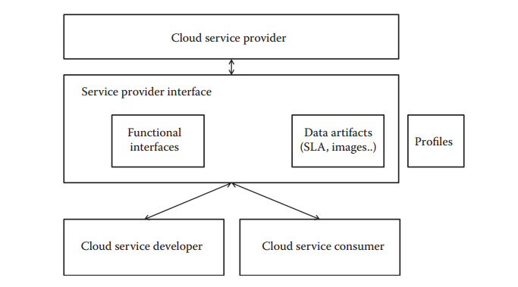
Cloud Management – Functional Components

Slide 15
Cloud Management – Functional Components
1. Cloud service developer: Designs, implements, and maintains service templates. 2. Cloud service consumer: Provides access to services for service users. 3. Cloud service provider: Supplies cloud services to internal or external consumers. 4. Data artifacts: Control and status elements exchanged across the provider interface. 5. Provider interface: Interface that allows consumers to access and monitor the contracted services. 6. Profiles: Specification that defines the associations, methods, and properties for a management domain.

Slide 16
Mobile Cloud Computing (MCC)
Mobile Cloud Computing at its simplest, refers to an infrastructure where both the data storage and the data processing happen outside of the mobile device. Mobile cloud applications move the computing power and data storage away from mobile phones and into the cloud, bringing applications and mobile computing to not just smartphone users but a much broader range of mobile subscribers.

Slide 17
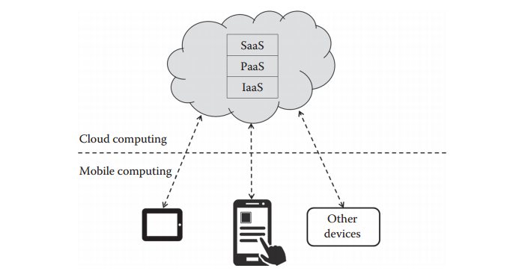
Mobile Cloud

Slide 18
Mobile Cloud
MCC is basically the intersection of the fields of cloud computing and mobile networks.
Mobile networks are basically networks that connect mobile users.
The emergence of ultrafast mobile networks makes it necessary to bring the cloud domain to the mobile networking domain.
This field is still in its primary stage of development.
MCC basically enables the building and hosting of mobile applications over the cloud.
There are various issues to be resolved such as live VM migration, security, privacy preserving, and fault tolerance.
There is a probability that migrating VMs become an overhead in MCC.
Mobile devices usually have limited computing power and resources.
The limitations of mobile computing can be overcome by MCC.
It will allow users to access platforms and applications provided by the cloud through their mobile devices.
Here, the users will no longer be restricted by the limited resources they own.
Thus, more computing-intensive mobile applications can be supported by a larger number of devices.

Slide 19
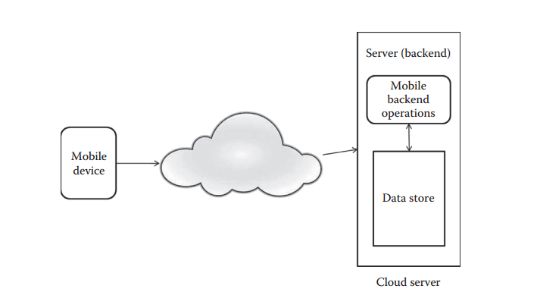
Mobile Cloud

Slide 20
Mobile Cloud - Scenarios
In mobile applications that involve image processing, natural language processing, multimedia search, and so on, the lack of resources on the mobile device can be handled by renting services offered by the cloud.
Another scenario is where mobile devices can themselves become part of a cloud and offer their resources for rent to other mobile devices.
Thus, collective resources can be made available, provided that they fall within the vicinity.
Another scenario makes use of cloudlets. Cloudlets are basically a collection of multicore computers connected to remote cloud servers.
Mobile devices usually act as thin client devices to the cloudlet.

Slide 21
Mobile Cloud - Challenges
the process of handing over the jobs to the cloud.
This greatly depends on the distance that physically separates the cloud and the mobile device.
the support of user mobility
There should be mechanisms to identify the current location of the mobile client.
The mobility of the users should not affect the connectivity to the cloud.
Energy efficiency is another aspect that requires intense research in the context of MCC.

Slide 22
Mobile Cloud - Benefits
Extending battery lifetime
Improving data storage capacity and processing power
Improving reliability
Improving scalability

Slide 23
Media Cloud
Multimedia data are the major form of data available in the Internet nowadays. In the case of videos, there are a wide variety of formats available. Storing and processing multimedia data require a large amount of processing and storage facilities. The currently emerging technology, cloud computing, can be utilized to efficiently process and store such data.
Media cloud provides storage for media data and also enables the presentation of data using media signaling protocols.
Media clouds provide distributed processing of multimedia data and provide services with high Quality of Service (QoS) for multimedia data.
The content stored in media cloud can be easily streamed to various clients such as music players in cars and smartphones, using protocols such as transmission control protocol (TCP), user diagram protocol (UDP), and real-time transport protocol (RTP).
The process of streaming includes the activities of buffering, rendering, recording, and mixing of data. The users of media cloud will also be provided with an easier way to share multimedia data among them.

Slide 24
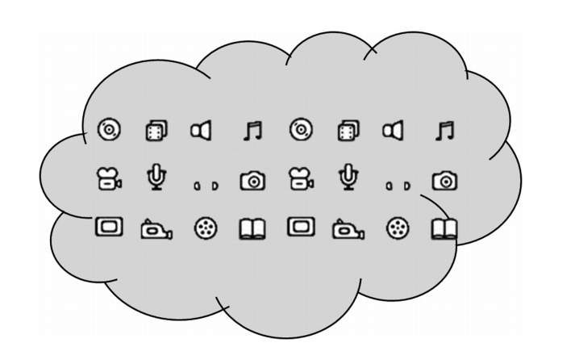
Media Cloud

Slide 25
Media Cloud - Challenges
The challenges come in the form of heterogeneous formats available for the different types of multimedia data, heterogeneity of applications, scalability to adapt to newly developed formats of media, and at the same time making the multimedia cloud a profitable cloud. For increasing the profit, the risk of failure should be decreased.
The only solution to the bursty increase in multimedia in the coming years will be cloud computing.
The cloud will be the major host for all multimedia data and multimedia processing in the near future.
In order to make the systems less complex, an approach that transforms the heterogeneous types of audio, video, and other multimedia data into a standard format is more desirable.
The area of media cloud has various unresolved issues such as media cloud architecture, storage, delivery of multimedia data, mobile broadcast, energy efficiency, and media mining that involves information retrieval from multimedia data.
The media cloud can also be used for provisioning to meet Video on Demand requirements.

Slide 26
Media Cloud - Architecture
the basic services that should be provided by a media cloud: storage and infrastructure management, cluster and grid management, workflow automation, etc.
This architecture contains five main components: 1. Cloud administrative services 2. Ingest services that accept media input from a wide range of sources 3. Streaming services 4. Video services that manage and deliver videos across media channels to various clients 5. Storage subsystems for content cache and movement, storage, and asset management

Slide 27
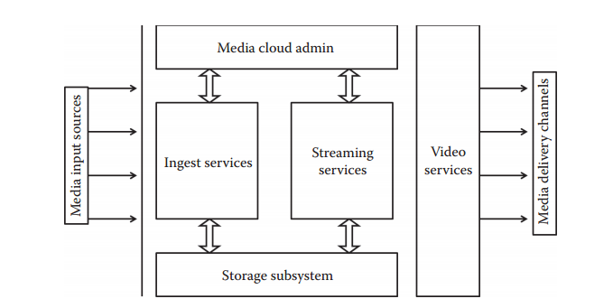
Media Cloud - Architecture

Slide 28
Interoperability & Standards
Interoperability is defined as the ability to move the workload from one cloud provider to another without any problem.
Thus, a user should be able to use the cloud providers interchangeably or should be able to shift their work base from one cloud provider to another.
Interoperability is one of the prime issues in cloud computing.
One of the problems associated with interoperability is vendor lock-in problem.

Slide 29
Cloud Governance
Governance is a term in the corporate world that generally involves the process of creating value to organization by creating strategic objectives that will lead to growth of the company and will maintain a certain level of control over the company.
Governance is not to be confused with management.
Both terms, though similar, have lot of difference.
Governance comes into picture where there is a booming industry that involves a lot of resources including people.
Governance involves maintaining and following certain policies throughout the company.
These involve high-level decision making that would affect all the people related to the company.
Key areas:
Quality of service:
Complying with the laws and standards
Adapt to changing service mechanisms
Data privacy issue
Multitenancy
Governance inside the organization (internal)

Slide 30
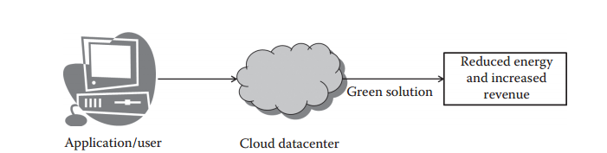
Green Cloud

Slide 31
Cloud Analytics
Cloud analytics is a process of doing any business or data-intensive analysis (data analytics) in public or private cloud.
Data analytics is a process of examining unprocessed or raw data to make some meaningful conclusion from the data.
The results may include either a value or a set of values or a graph.

Slide 32
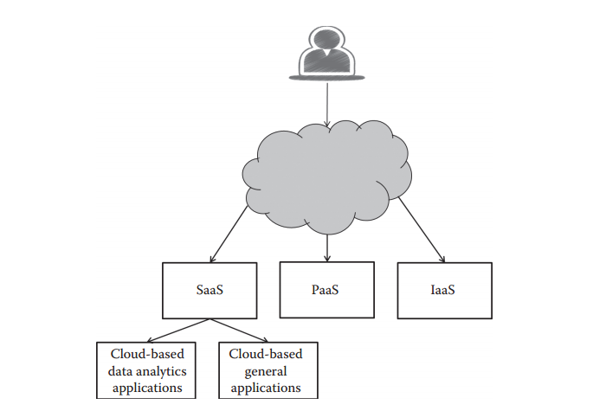
Cloud Analytics

Slide 33
Thanks

